Slide 1

Data-driven well-being
Teaching life satisfaction through prediction and visualization
Anna Lorenz 429840
Berker Basergun 474551
Zofia Broszczak 446277
Big Data Analytics - Data Science and Business Analytics

Slide 2
Project’s objective - optimizing your happiness
Explain and predict life satisfaction
Focus on helping you understanding what is the cause of your (un)happiness and what you can do to improve your well-being.
Medallion architecture implementation in DataBricks
BRONZE
SILVER
GOLD
Raw survey data and metadata ingestion
Data preprocessing and creating one final dataset
Machine learning models and PowerBI visualizations

Slide 3
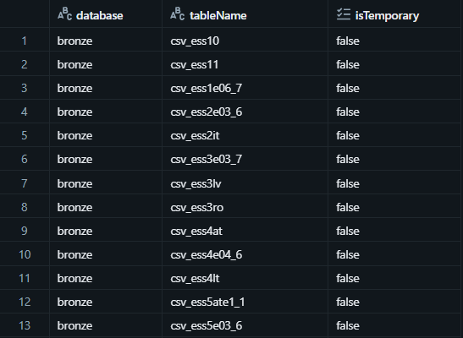
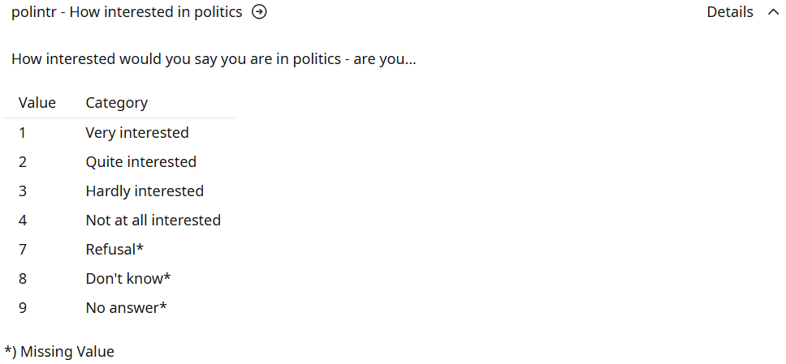
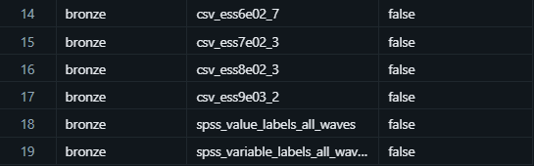
Bronze layer - Data ingestion
European Social Survey (https://ess.sikt.no/en/):
- survey data measuring public attitudes, beliefs and behaviour.
- 11 rounds, every two years
- CSV data: 17 datasets, 500-600 variables per round (present in one, some or all rounds, may require harmonization across rounds)
- SPSS data: variable label and value label metadata tables

Slide 4
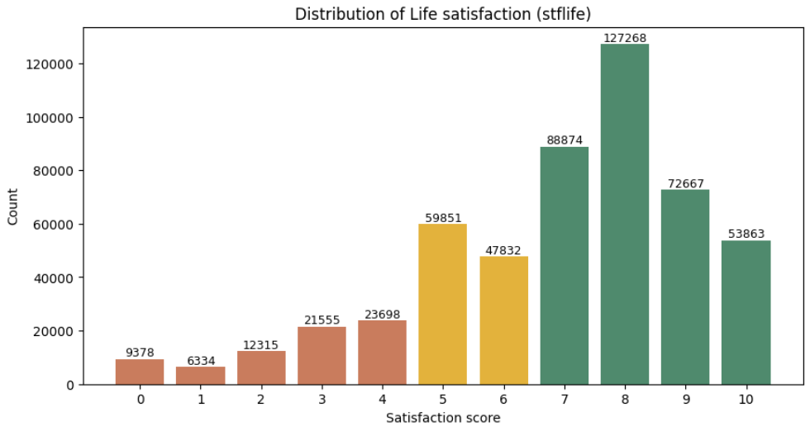
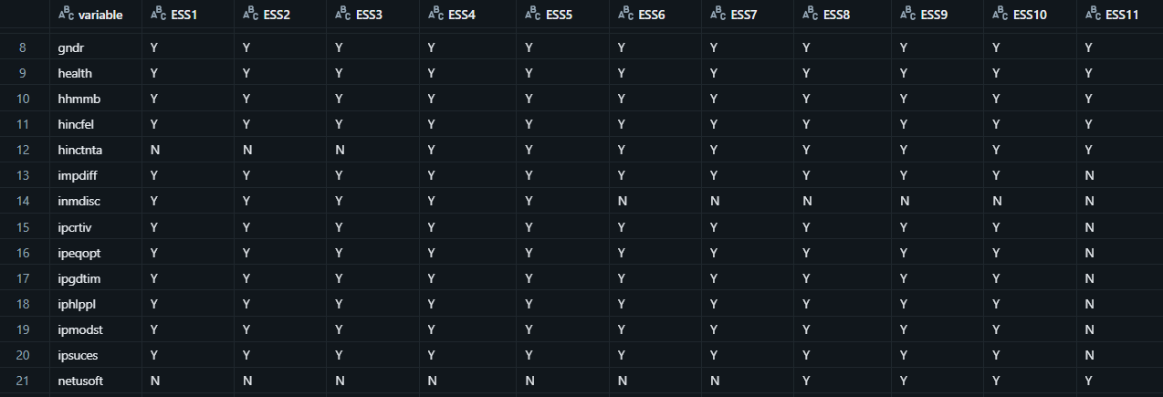
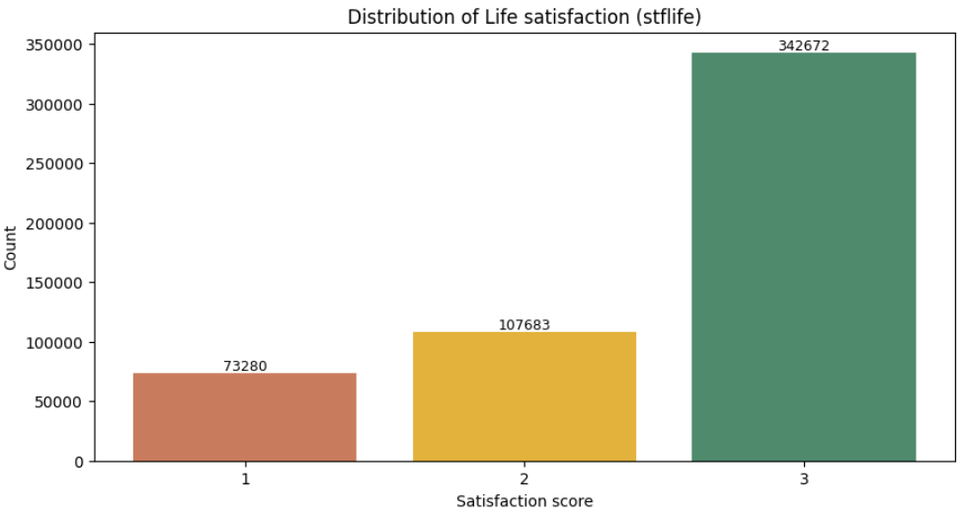
Silver layer
Data preparation and dataset creation
1. Feature selection
- Target variable - life satisfaction
- Cannot control but important for context (country, age, gender, household size)
- Can partially control (income, years of education, unemployment, health, religiosity)
- Can control (frequency of social meetings, social activity, close relationships, mindset, political interest, frequency of internet use, weekly worked hours)
2. Variable harmonization across all ESS rounds
3. Combining all rounds to one dataset
4. Recoding variable-specific missing value codes to NaN using SPSS metadata
5. Target variable distribution and recoding
6. Saving the final dataset as a Silver Delta table

Slide 5
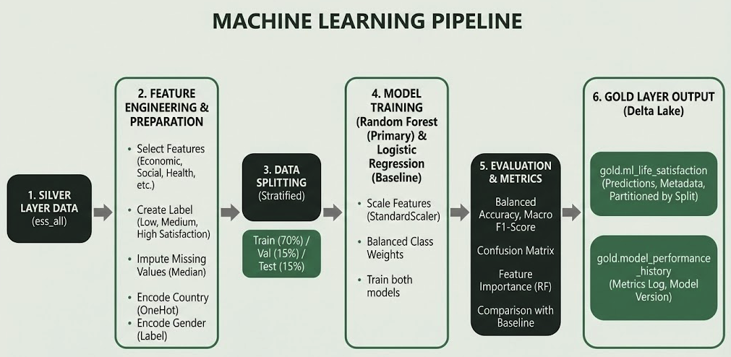
Dataset: European Social Survey (ESS)
Sample size: 500,000+ observations across 39 countries
Target variable: Life satisfaction (3 class ordinal)
Features: 17 predictors
Domains: Economic, social, health, demographic
Strategy: Stratified sampling preserves class distribution

Slide 6
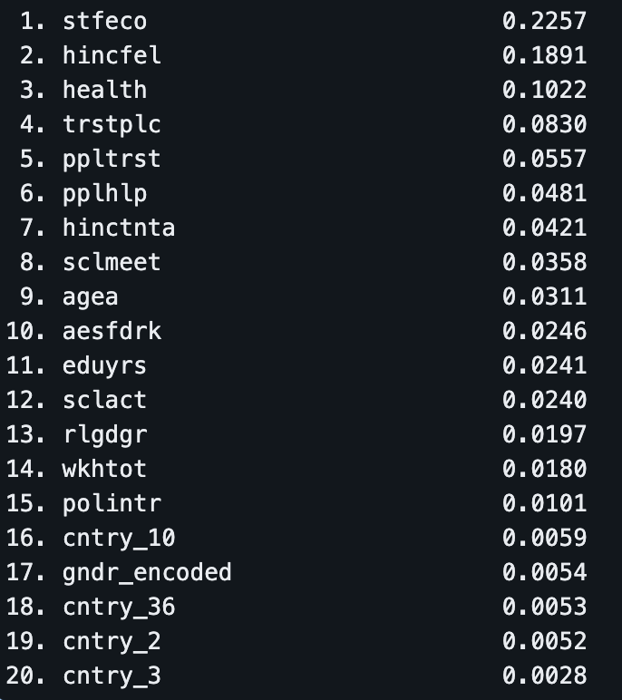
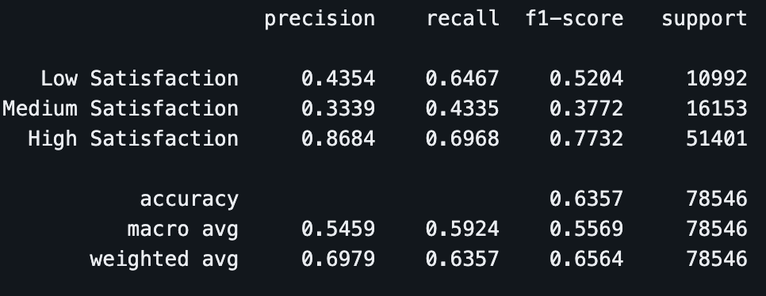
Feature Importance Analysis
Class weighting prevents the model from defaulting to the majority class
Macro avg (54.59% precision, 59.24% recall) shows model learns all classes
Weighted avg (69.79% precision) inflated by majority class dominance
Random Forest: 59.24% balanced accuracy (beats 58.68% baseline)
Top predictors: Economic satisfaction (23%), Income feelings (19%), Health (10%)
Economic factors account for 42% of total feature importance
Consistent train/val/test performance indicates good generalization
Per-Class Performance

Slide 7
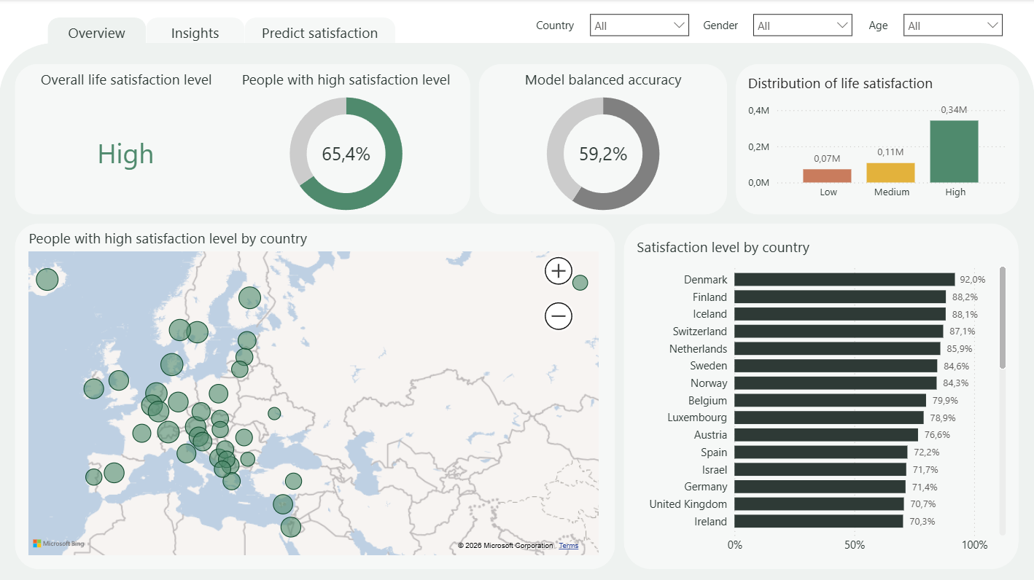

Slide 8
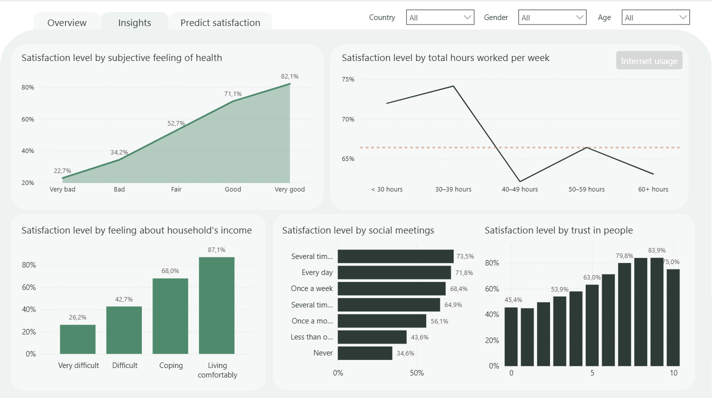

Slide 9
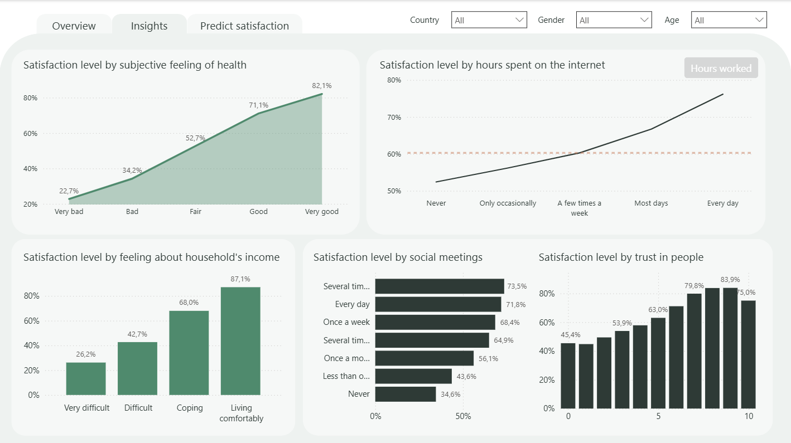

Slide 10
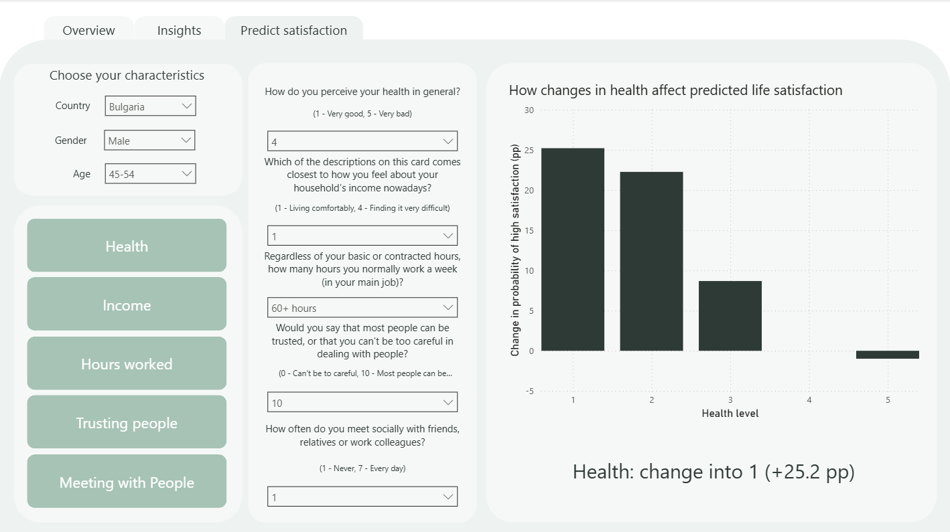

Slide 11
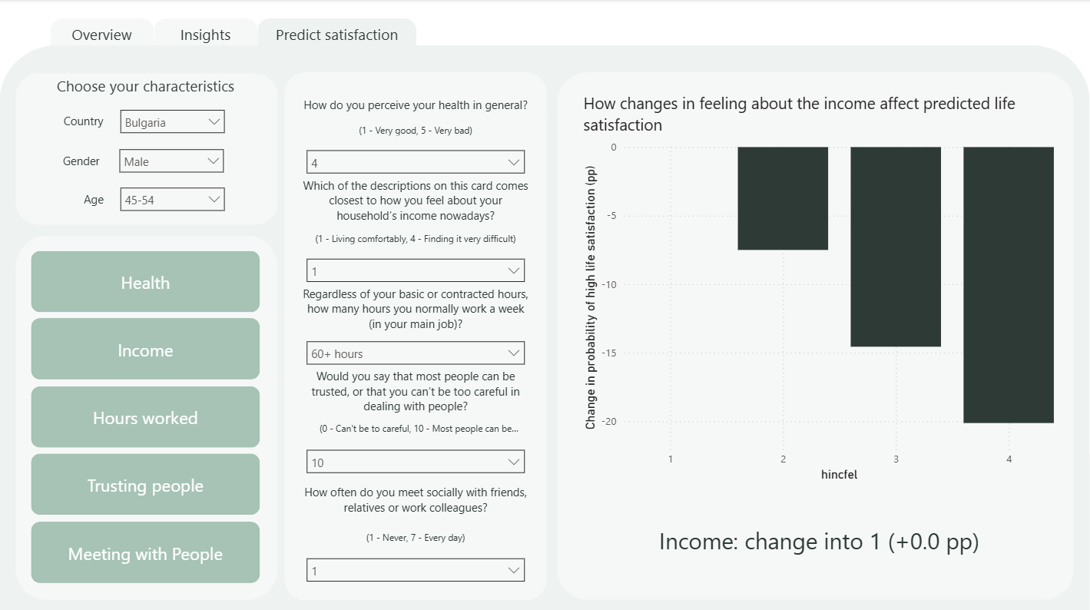

Slide 12
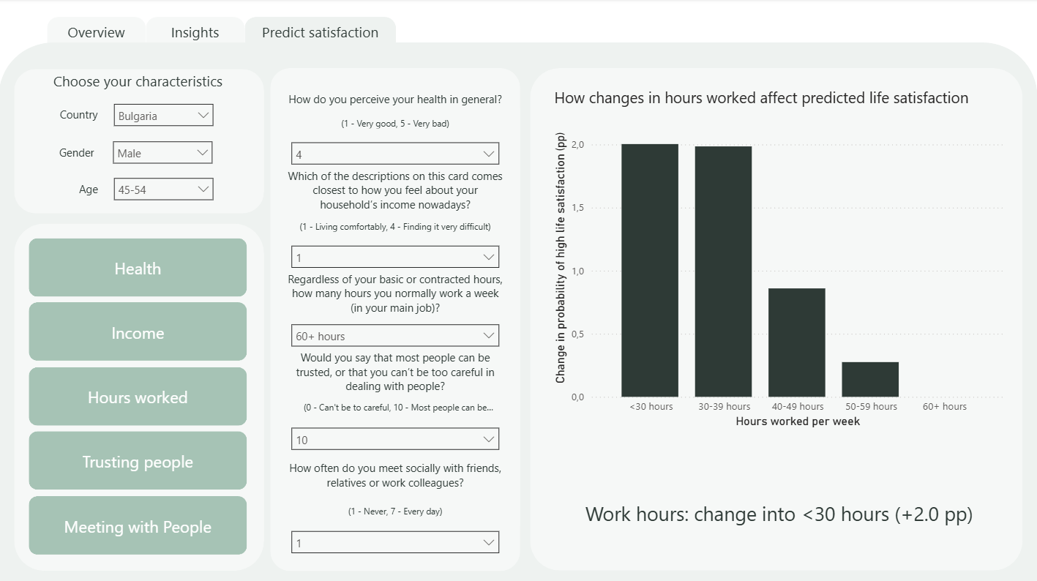

Slide 13
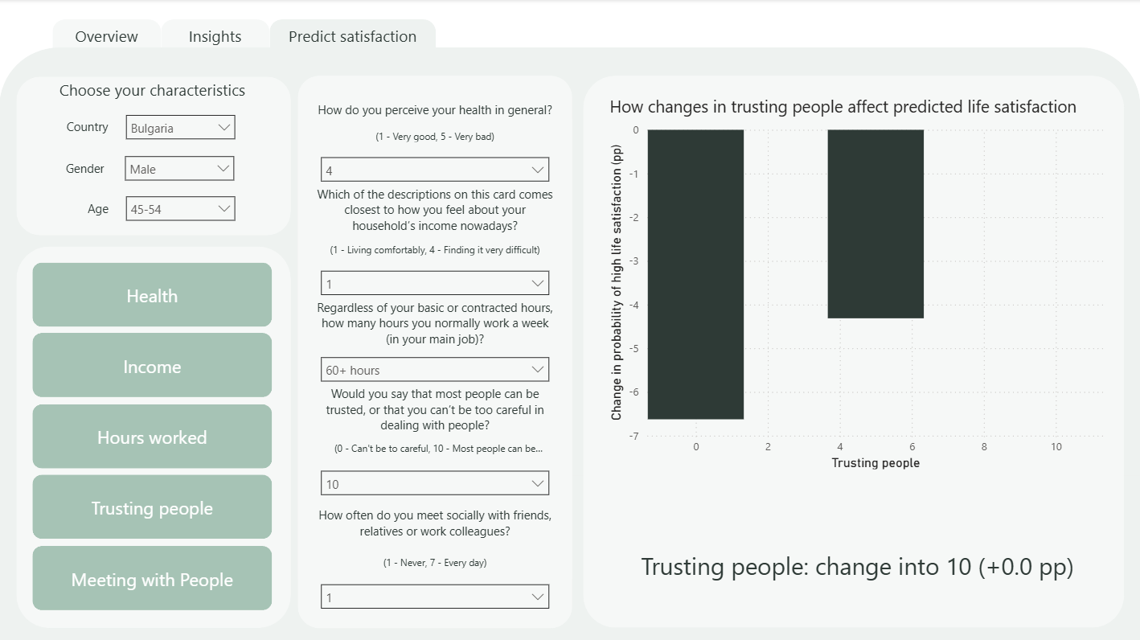

Slide 14
